Slide 1
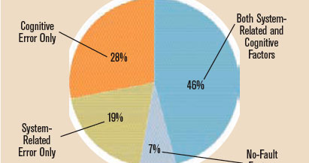

Slide 2

The need for artificial intelligence in healthcare
Speech by
Alec meyer

Slide 3

Overview
Diagnosis Accuracy
Patient Anxiety
Possible Concerns

Slide 4
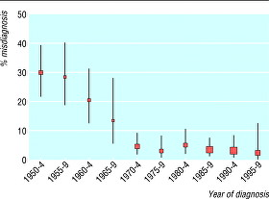
Diagnosis Accuracy
Mis-diagnosis
Help diagnosis proficiency

Slide 5

Social Anxiety
Going to the doctors more frequently
Allows more patient transparency

Slide 6
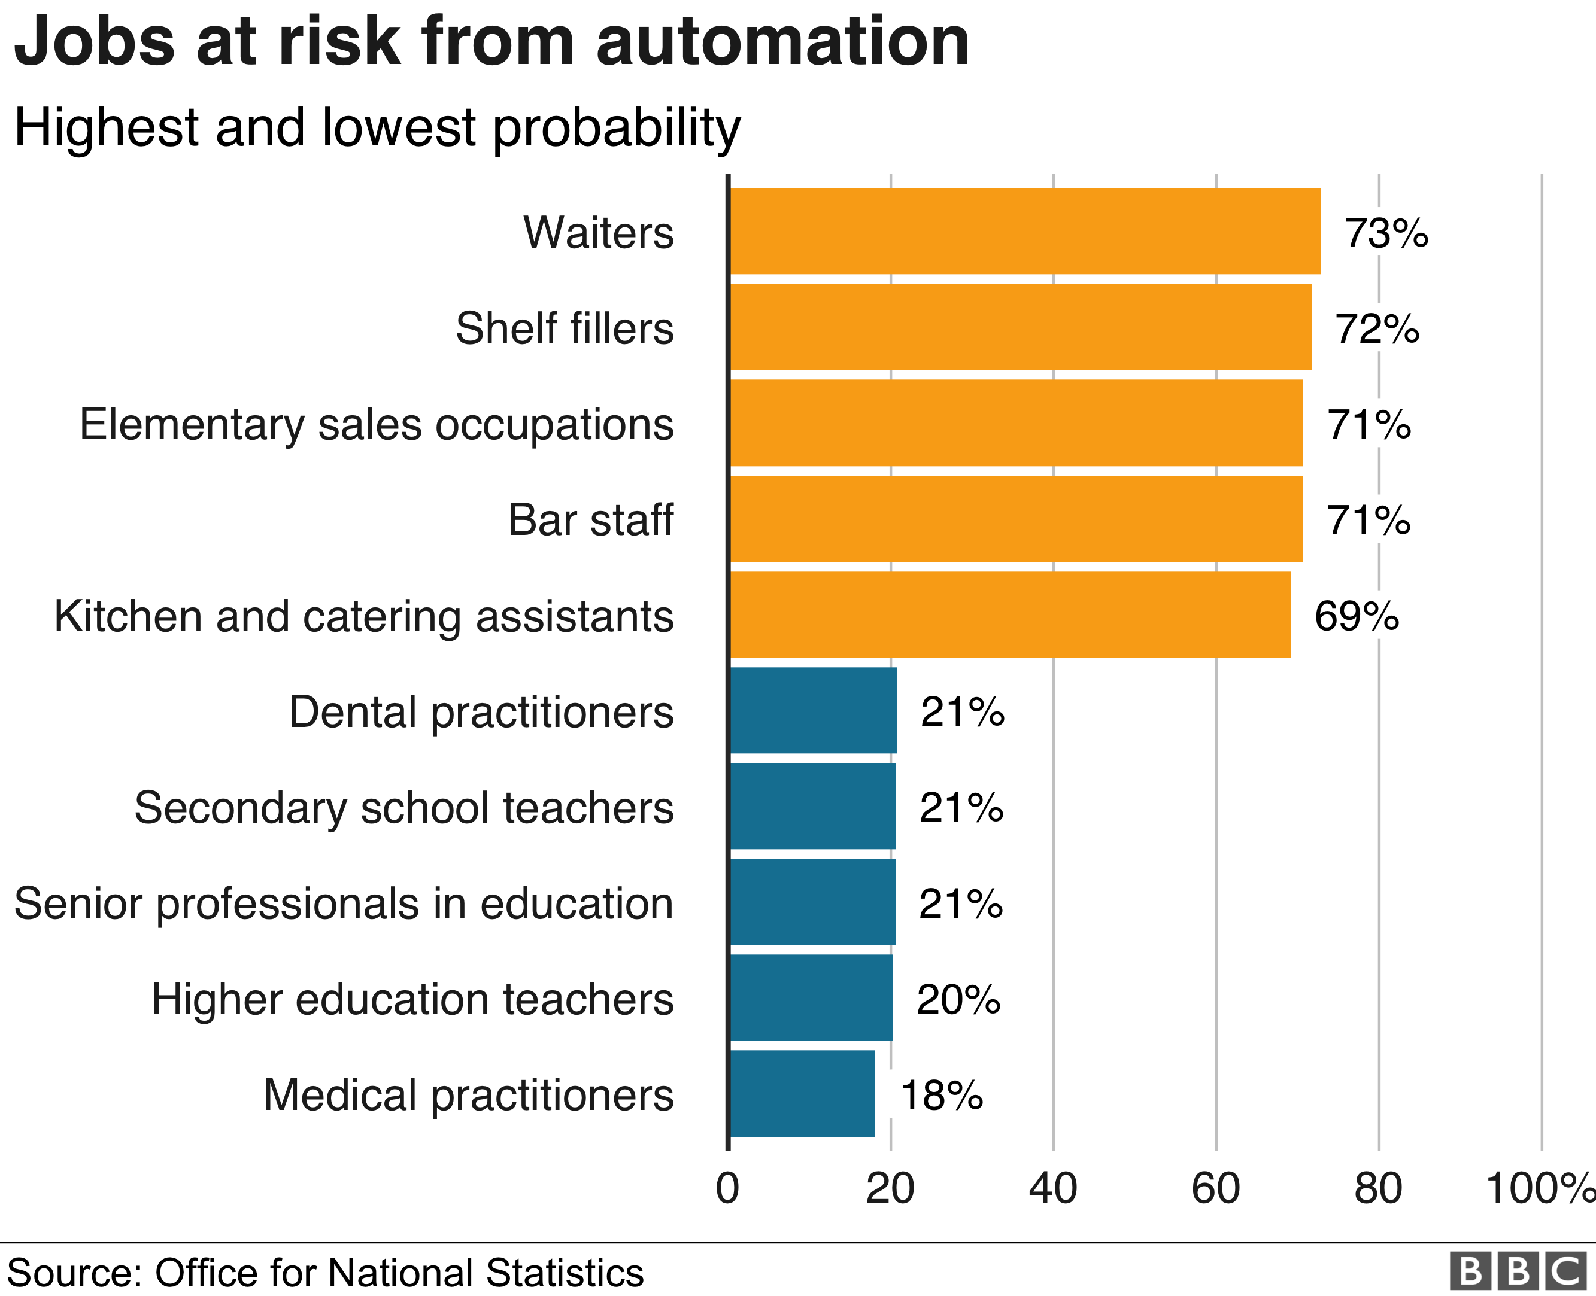
Concerns
Loss of jobs
Technology

Slide 7

What can you do?
Stay informed on the state of AI
Support the migration to AI

Slide 8
Thank you

